Slide 1


Unit 5: Lesson 15 Living on the Moon

Slide 2


Slide 3
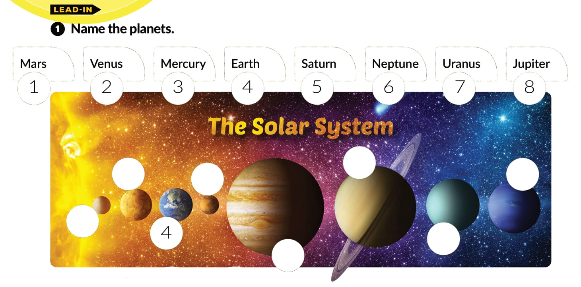
5
2
1
6
3
7
8

Slide 4

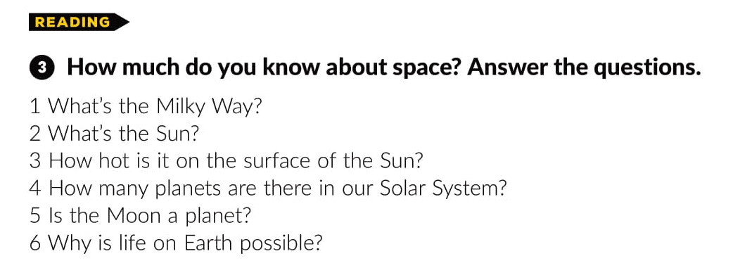
https://www.e-sfera.hr/dodatni-digitalni-sadrzaji/794c96df-cb30-47ea-8152-149a7f4e6c99/assets/audio/31__lesson_15___planets.mp3

Slide 5
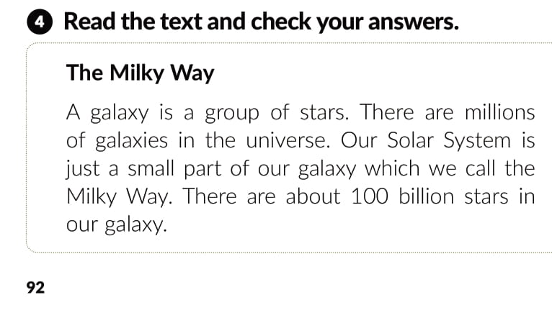
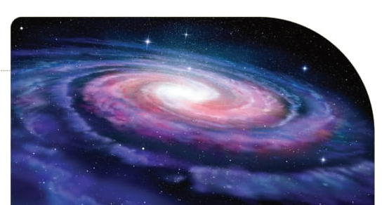

Slide 6
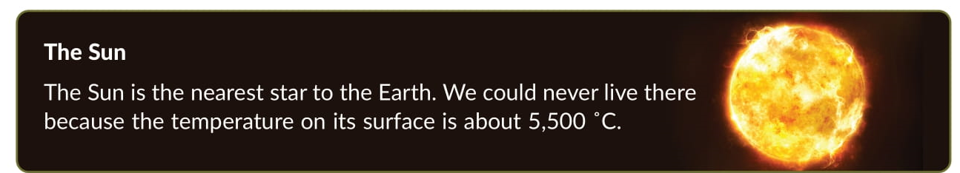
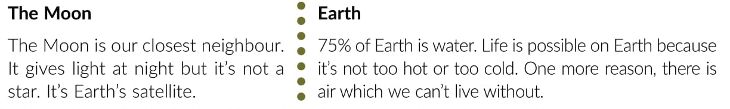

Slide 7


75 percent of Earth is water.
A day on Mercury lasts 59 Earth days.
There are about 100 billion stars in
our galaxy.
The temperature on the surface of the Sun is about 5,500 ˚C.

Slide 8
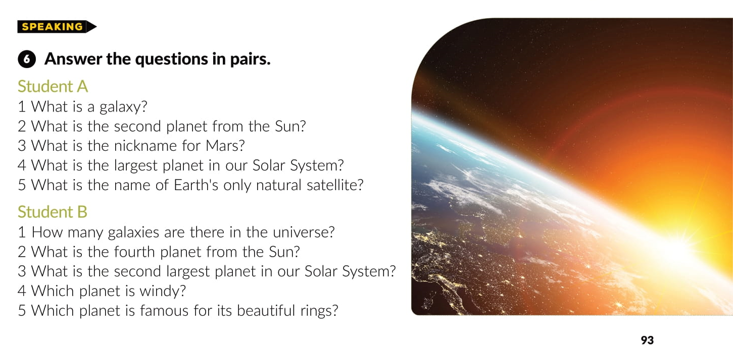

Slide 9
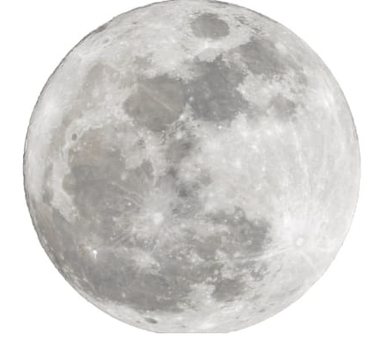
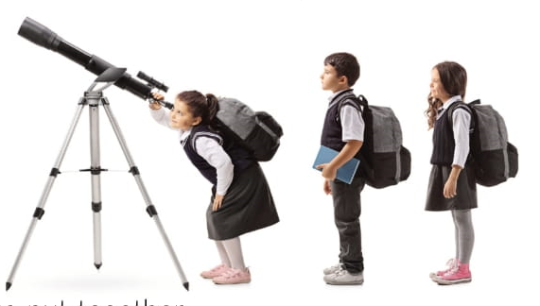
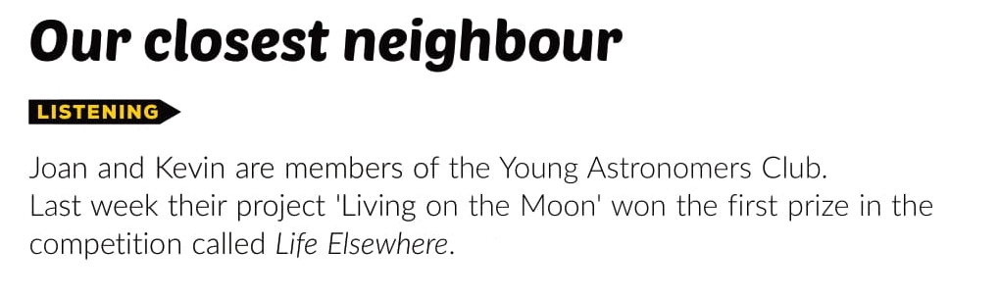

Slide 10
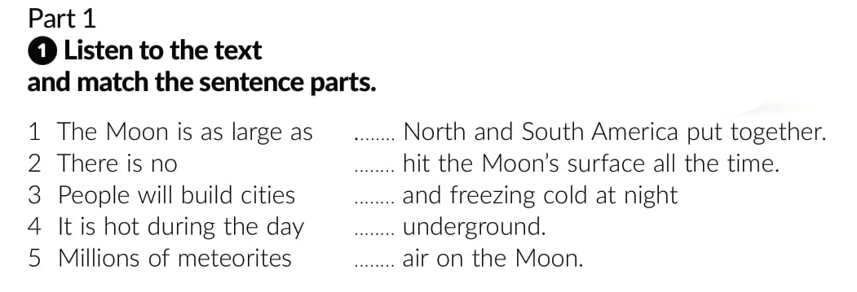
1
5
4
3
2

Slide 11
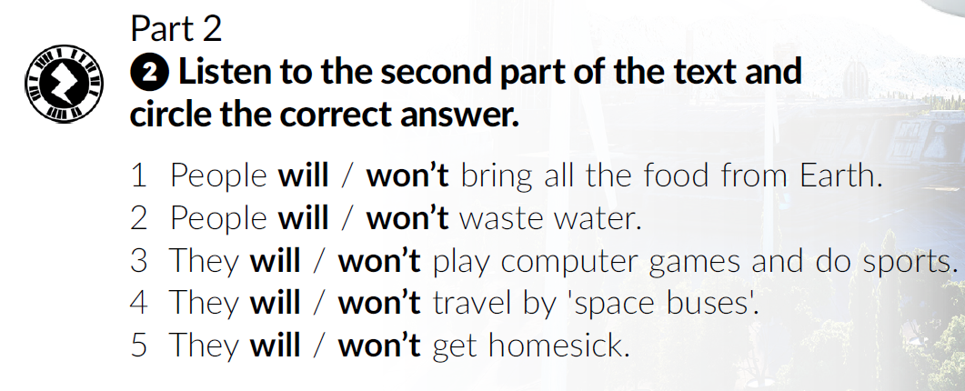

Slide 12
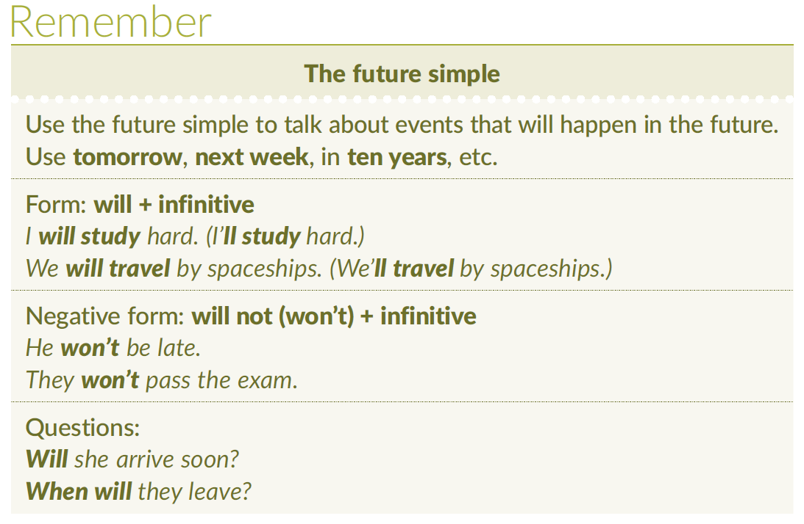

Slide 13
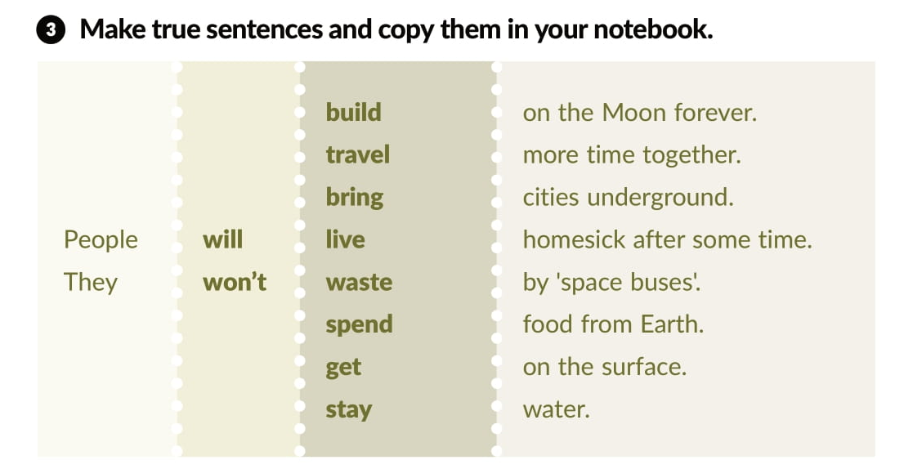

Slide 14
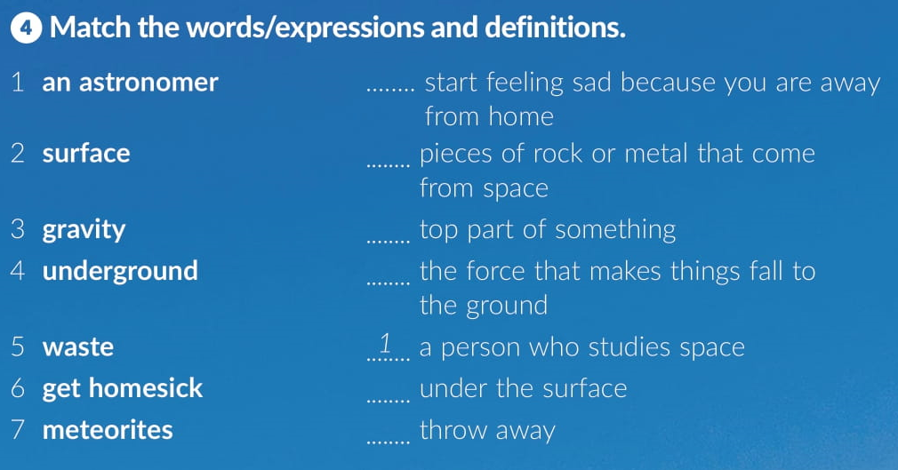
6
7
2
3
4
5

Slide 15
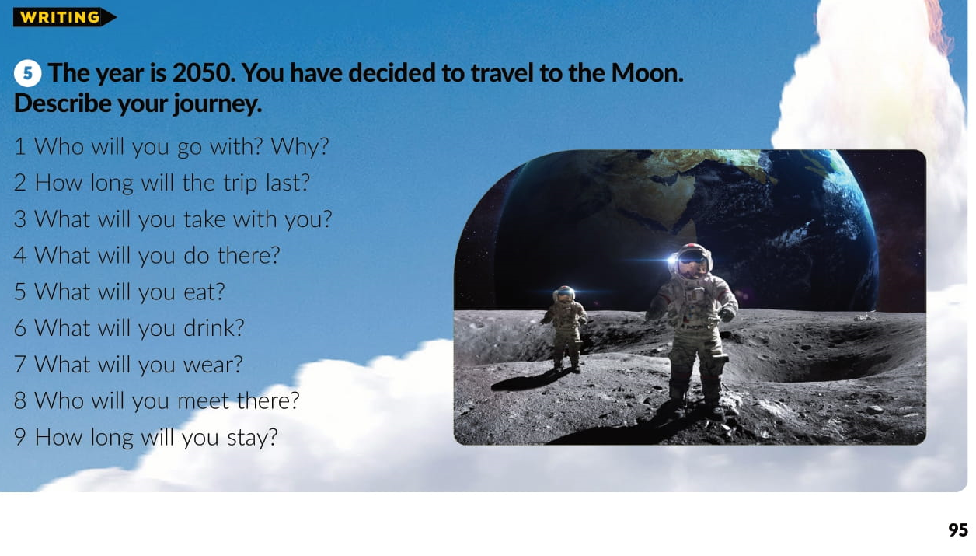

Slide 16
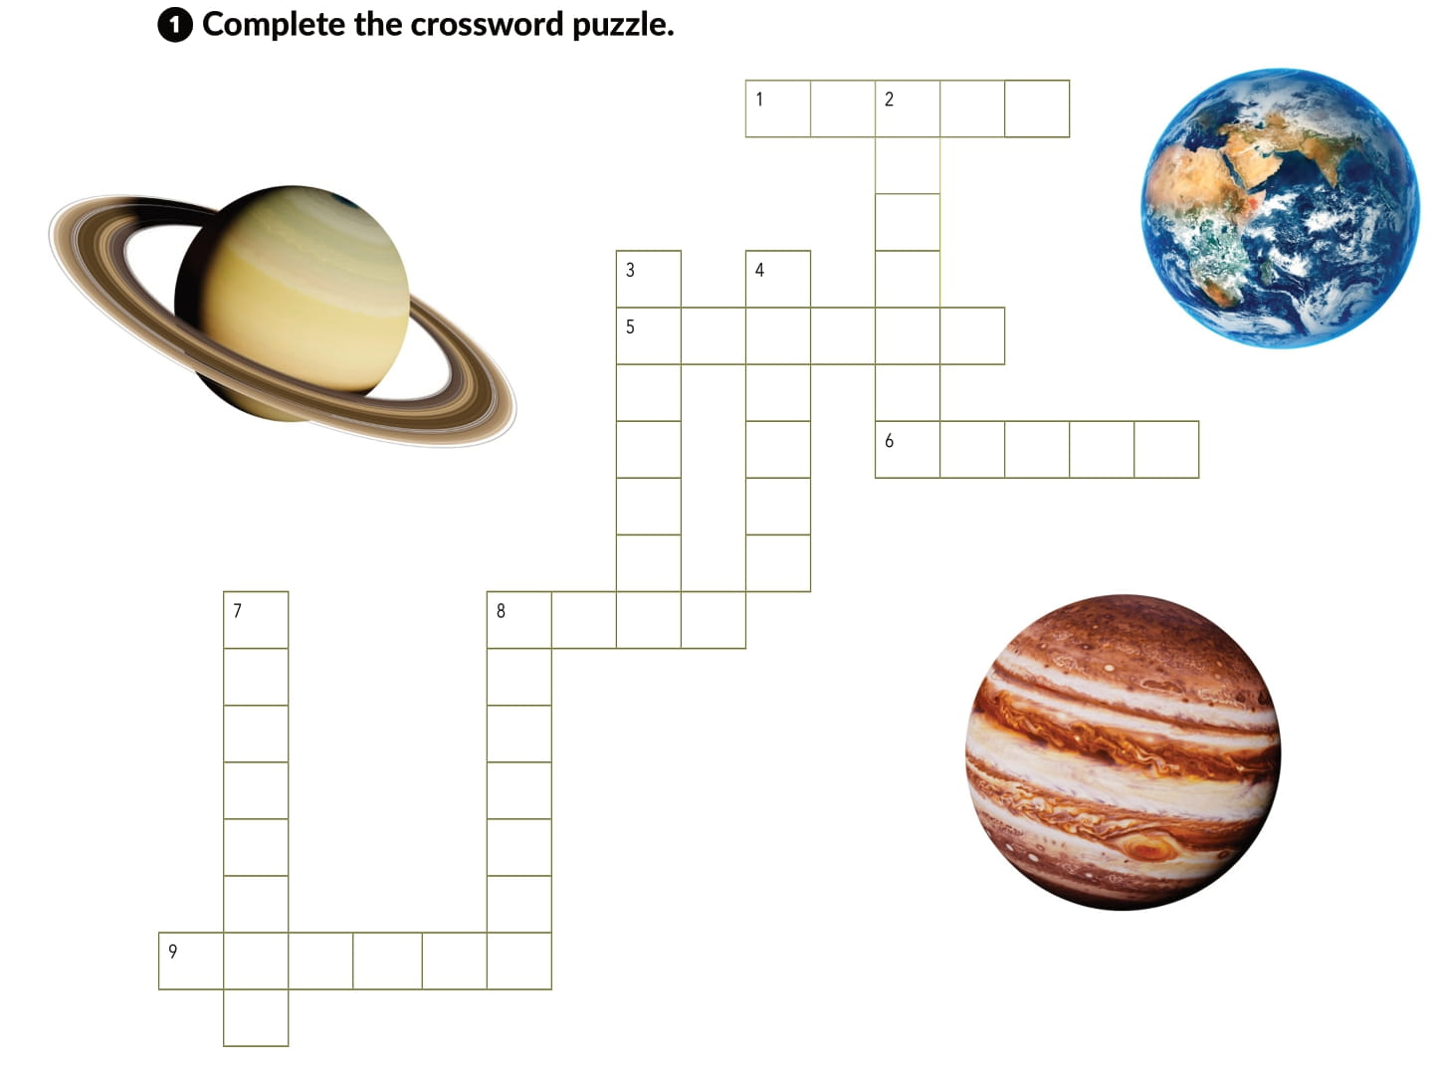
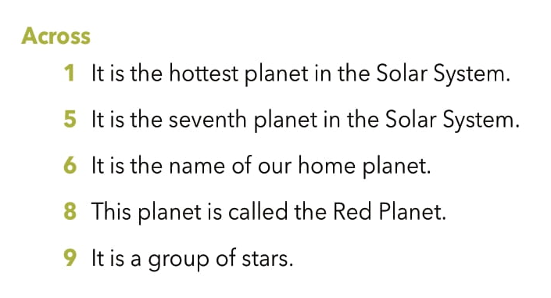
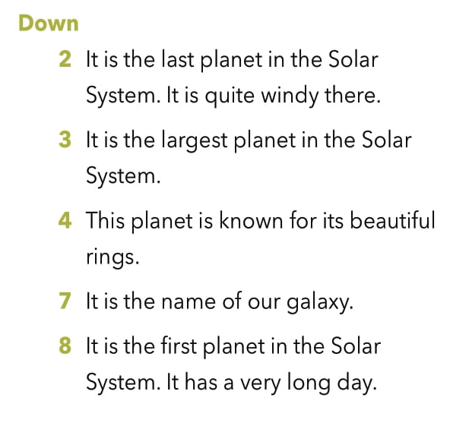
V E N U S
E
P
T
U
N
E
J
U
P
I
T
E
R
S
T
U
R
N
R A N S
A R T H
M
I
L
K
Y
W
A
Y
M E
R
C
U
R
y
A S
G L A X

Slide 17
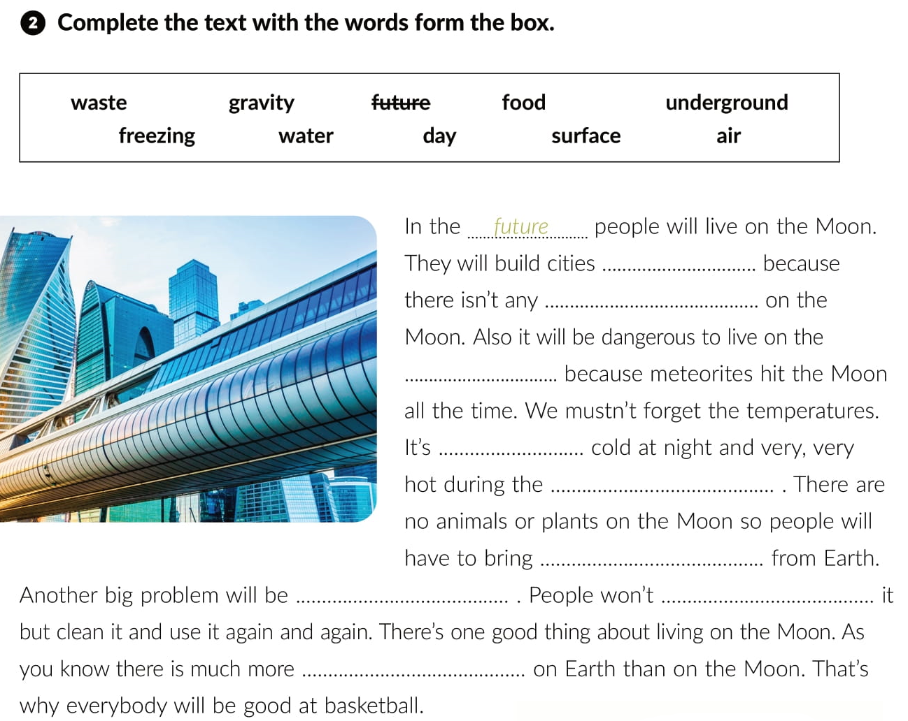
underground
air
surface
freezing
day
food
water
waste
gravity

Slide 18
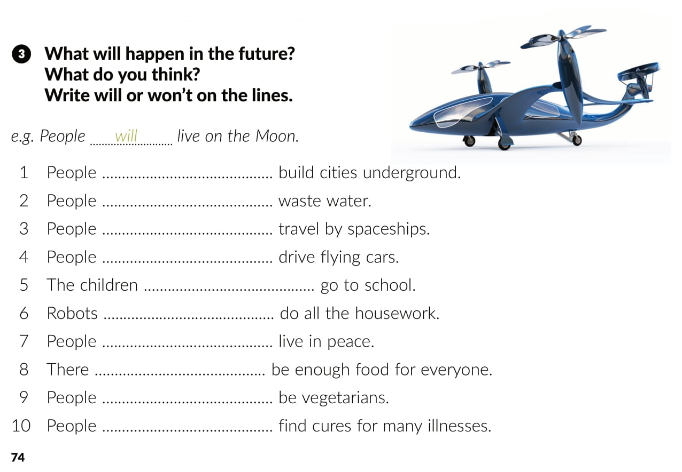

Slide 19

1 Where will you go next?
4 What will the weather be like?
2 Where will you be tomorrow?
5 Will you come to my birthday party?
6 How long will you stay in Italy?
7 What will you buy me there?
8 Will you text me all the time?

Slide 20
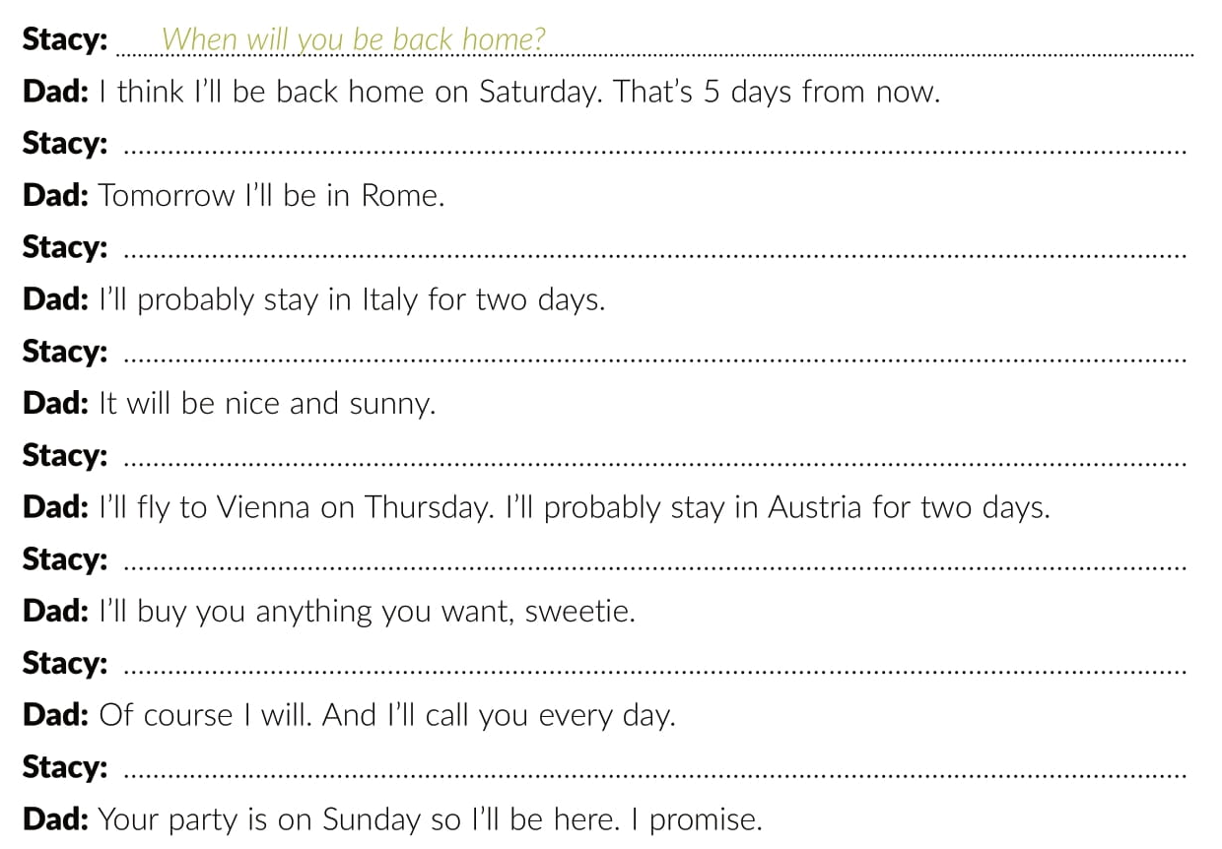
Where will you be tomorrow?
How long will you stay in Italy?
What will the weather be like?
Where will you go next?
What will you buy me there?
Will you text me all the time?
Will you come to my birthday party?

Slide 21
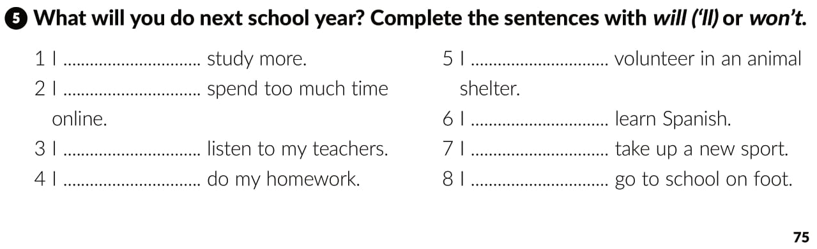

Slide 22

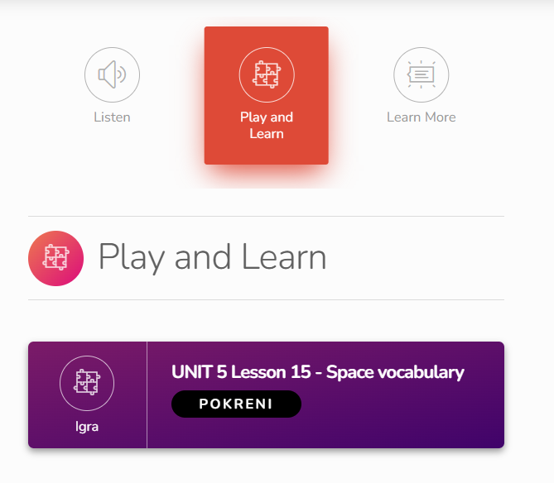
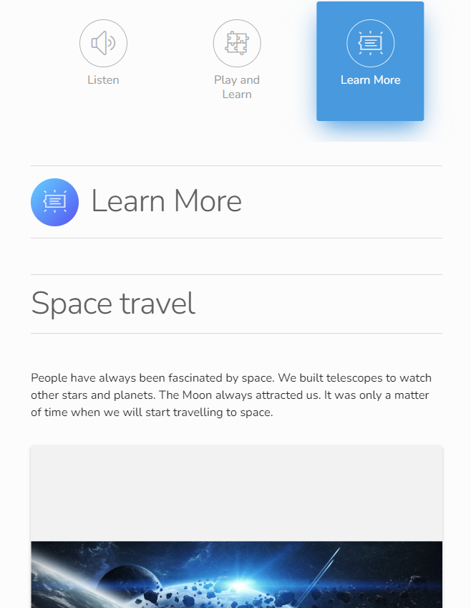
Otvori sljedeću poveznicu
Lesson 15 Living on the Moon | Way to go 3 (e-sfera.hr)

